Slide 1
LAKE KARLA
The Lake Karla is located in the central Greece, and more specifically northwest of the city of Volos. It could be said that this lake has its own “history or past.

Slide 2
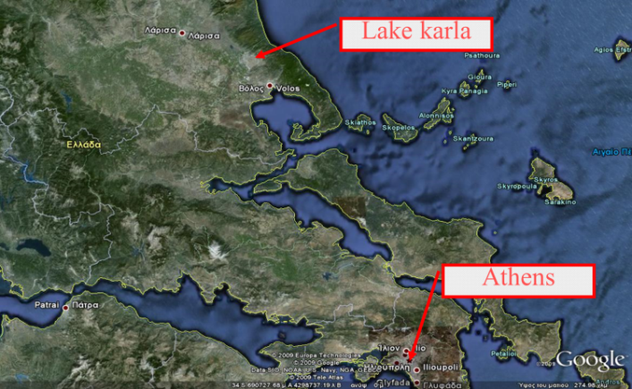

Slide 3
The first name of the lake was Voivis, also the name of the nearby ancient city, the area where today the village of Kanalia settles.The lake was part of the ancient Greek mythology, which argued that the god Apollo was married on its shores.

Slide 4
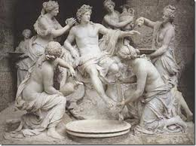
God Apollo

Slide 5
This 180 km2 (20.000 Ha) lake was completely drained in 1962 to protect from floods and to gain land for agriculture. Before its drainage, it was the site of a unique fishermen culture, with the fishermen spending almost nine months of the year in reed huts that they built on the water. The lake fisheries were an important tradition and to some extent a significant economic activity.

Slide 7
Unfortunately, this decision of the lake had many negative consequences:
fish production vanished
climate changed for the worse,
big cracks occurred at the soil,
chemical degradation of the soil was detected,
pollution entered the Pagasitikos Gulf and
waterfowl almost disappeared.

Slide 8
Lake Karla in 1960

Slide 9
Lake Karla in 1962 after the drying

Slide 10
Lake Karla today

Slide 11
Shortly, it became evident that the drainage was an absolut failure and numerous studies started being conducted
Measures for the protection of ecology
Creation of an artificial lake on flooded permanently higher rate
The development of a variety of vegetation without betraying the man character of the lake.
Maintaining water quality at levels so not to cause toxicological problems in humans or animals.
Successful support of the natural colonization of wetland plants and various animals
Providing shelter to endangered or rare species.

Slide 12
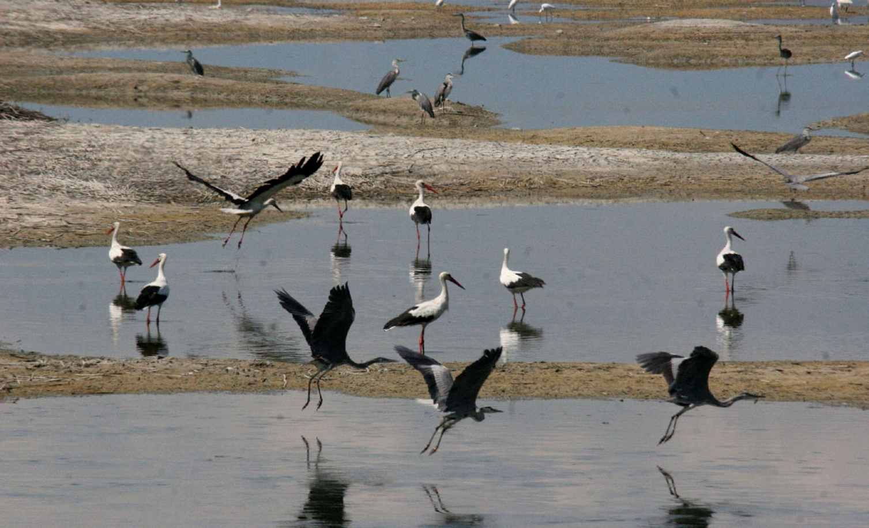
Ecology in the area
In area of the lake Karla there have been spotted 60 species of birds and 12 species of fish that are a quite big number.

Slide 14
Local authorities in Thessaly are ringing the alarm bell over the state of Lake Karla. Local groups including a body tasked with the management of the lake, called for “measures as fast as possible to combat the pollution of Lake Karla.”

Slide 15
Dead fish floating on Lake Karla.

Slide 17
Students of the 6th grade listening to the member of the local organization for the protection of Lake Karla.

Slide 18
6th grade visiting Lake Karla.

Slide 20
Conclusion
The restoration of Lake Karla is one of the ecologically most important Greek lakes because of the ecosystems and the environment in the surrounding area. There are many endangered species of birds and fish that have to remain safe. As result, there have been made many studies taking the ecological issues into account in order to realize the project without any harm to the ecosystems.

Slide 21
http://www.youtube.com/watch?feature=player_detailpage&v=LdlcPrzqWu8
http://www.youtube.com/watch?feature=player_detailpage&v=LdlcPrzqWu8#t=98
http://www.youtube.com/watch?feature=player_detailpage&v=vOziidJHxic#t=76
http://www.youtube.com/watch?feature=player_detailpage&v=Xt9lXTgYLJU#t=180
http://www.youtube.com/watch?feature=player_detailpage&v=MmdFBhfcVvY#t=154

